Slide 1

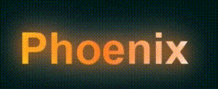
Smart-Dash

Slide 2


Merget system for user interface using raspberry pi
Phoenix team Embedded Linux track
Group-4

Slide 3
Table of contents
01
02
Introduction
Project overview
Methodology
04
Conclusions
03

Slide 4
Team
Amal Aly
Huda hussam
Mai el-Shahid

Slide 5

Introduction
01
Brief overview

Slide 6
5.54
12.57
17.8%
2024
2029
Annual growth rate
Market Analysis
2024 to 2029

Slide 7
Trends
Automotive
IOT
Industrial Automation and Robotics
30-40%
Intel, Qualcomm, Tesla, BMW, and Bosch
20-25%
Samsung, LG, and Sony
15-20%
Siemens, ABB, and Honeywell
10-15%
Startups

Slide 8
Locations
North america -Europe
Asia pacific region
40-45%
30-35%
Japan, China, and South Korea.
20-25%

Slide 9
Project overview
02

Slide 10
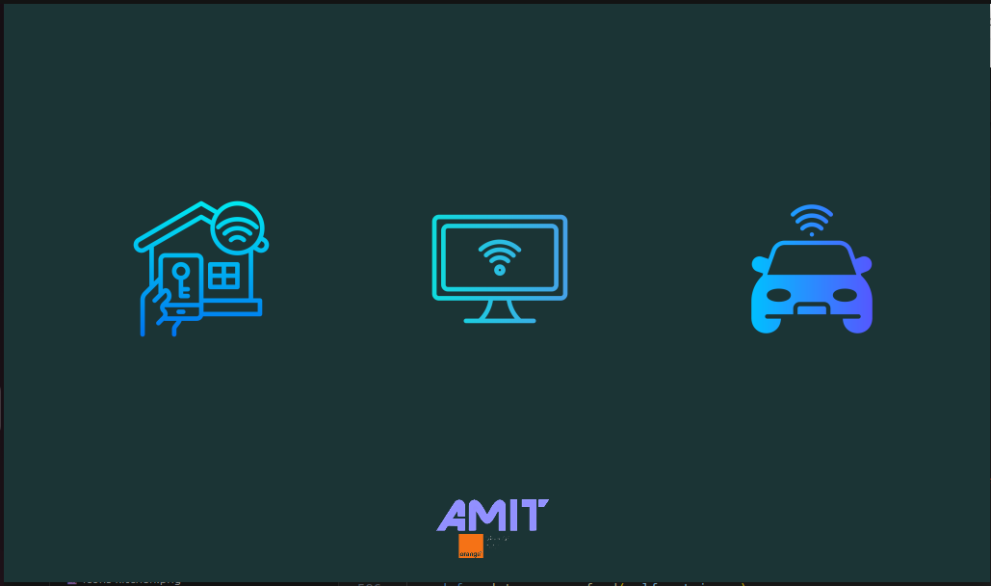
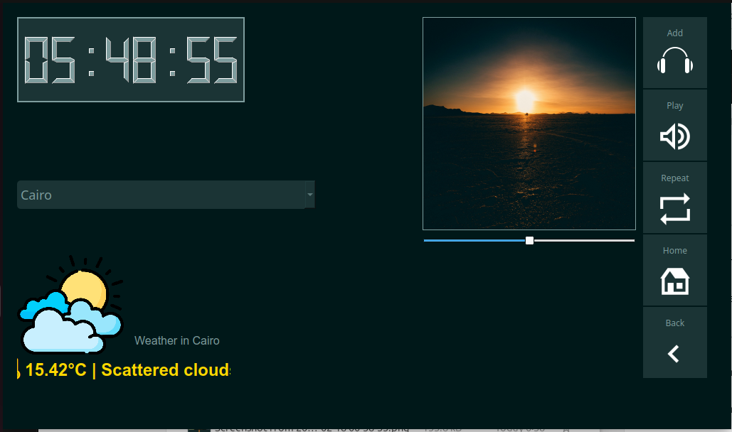
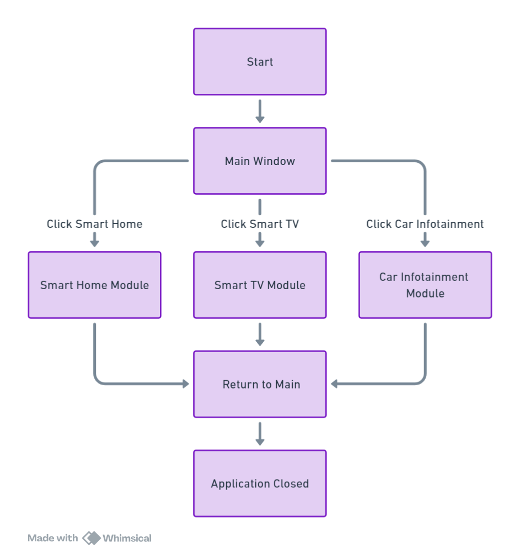

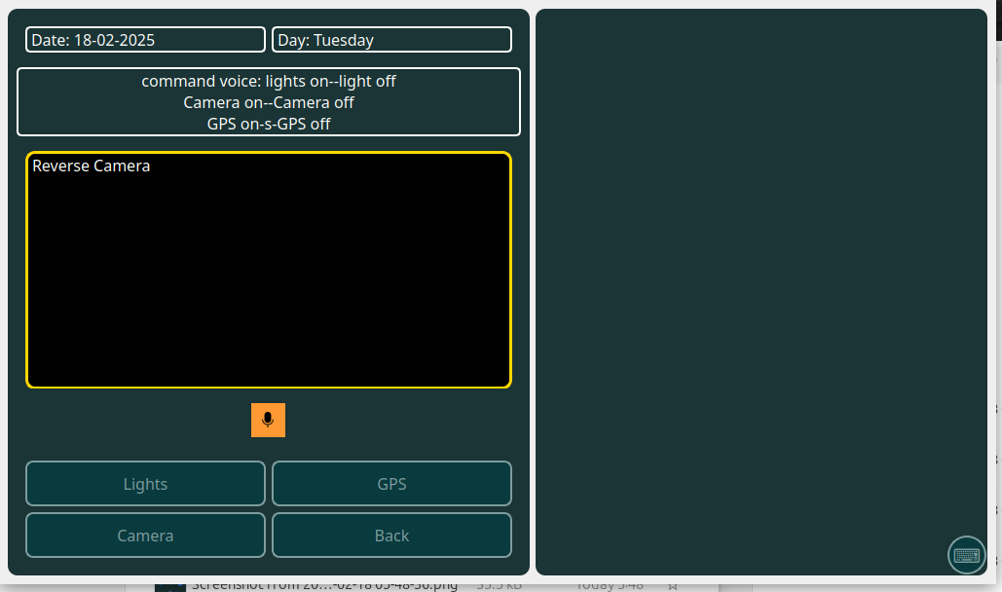

Slide 11
Methodology
03

Slide 12
Work flow
Requirement Gathering
brainstorming
Requirement Gathering
Design Phase
Project Initiation
brainstorming
Design Phase
Project Initiation
Development
Development
Testing
Deployment
Testing
Deployment

Slide 13


The Rise of Smart Homes in the Middle East
Revolutionizing Home Control from Your Car
due to advancements in IoT, AI, and smart city projects.

Slide 14

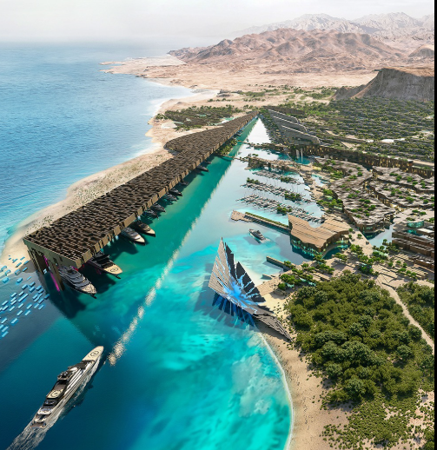
Smart Home Growth in the Middle East
Smart Dubai
NEOM
UAE
Saudi Arabia

Slide 15



Why Smart Homes?
Security
Convenience
Integration
Monitor and protect your home anytime.
Control your home remotely.
Connect multiple smart devices seamlessly.

Slide 16
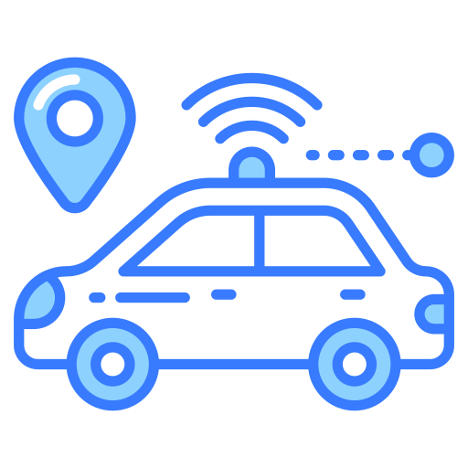
Your Smart Home Application
A car-integrated application that allows remote home control.
Ensures security, convenience, and seamless connectivity.

Slide 17
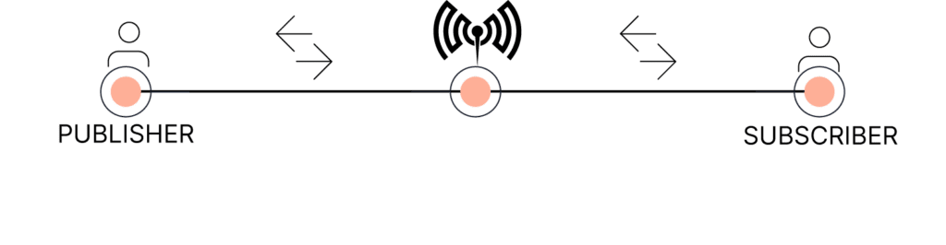
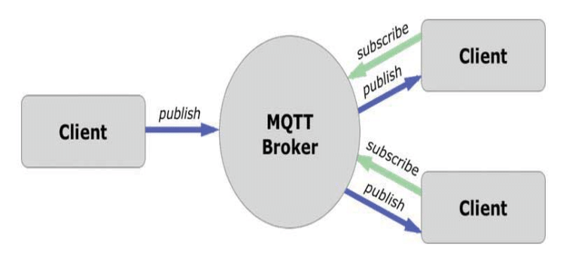
Your Smart Home Application

Slide 18




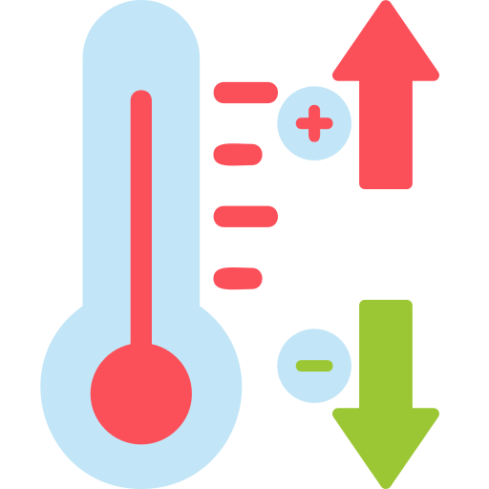

Key Features of the Smart Application
Music & Radio
Lighting
Turn home lights on/off remotely.
Play music or turn on the radio.
Temperature
Cameras
Check temperatures in multiple countries.
Monitor and control cameras remotely.

Slide 19

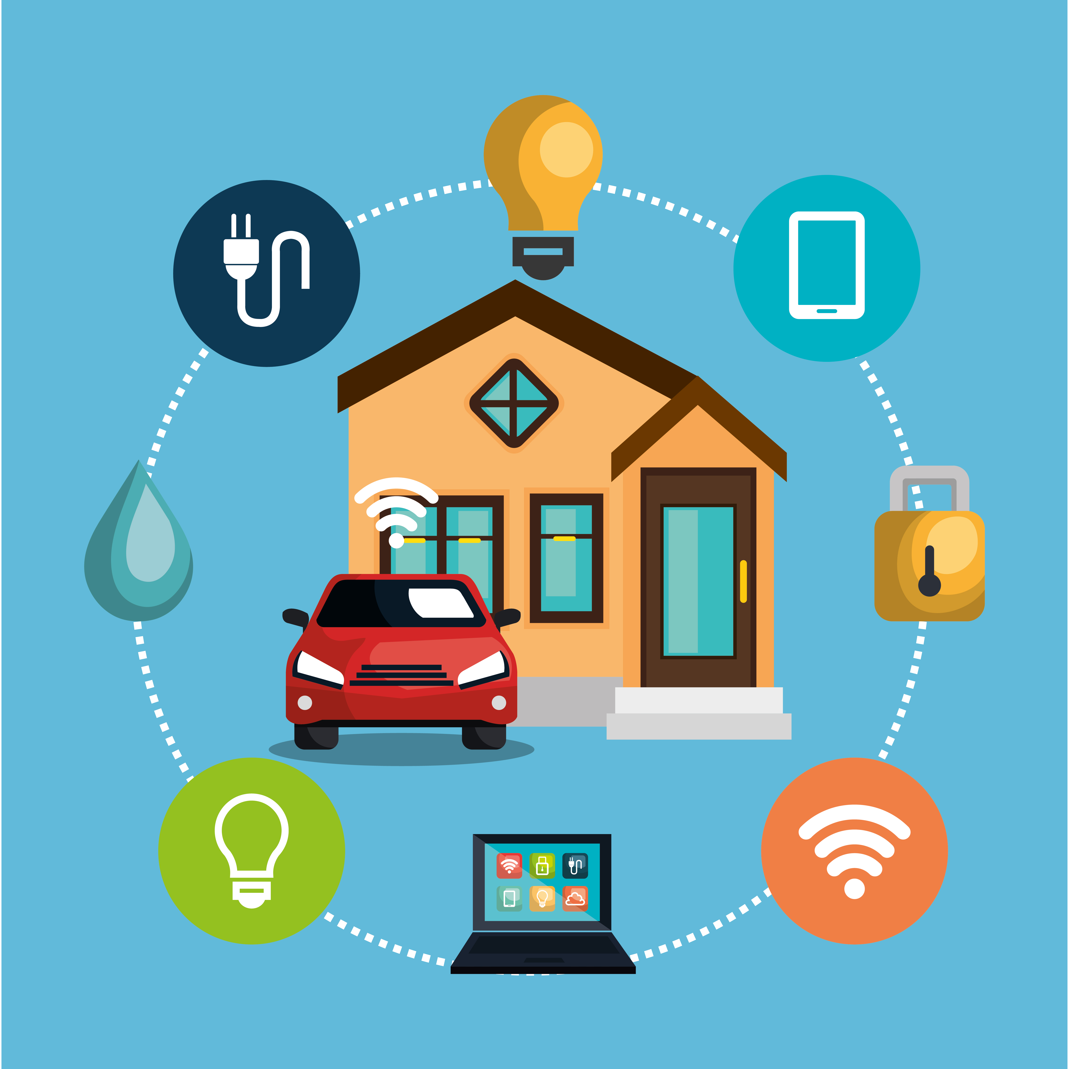

How It Works
The app connects via the internet to smart home devices.
Accessible from within the car via an intuitive interface.

Slide 20
Smart homes are the future of living, providing comfort, security, and efficiency.
smart application bridges home automation with automotive technology.
The Middle East is embracing smart living—now is the time to be part of the revolution!

Slide 21
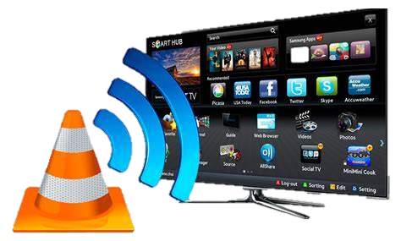
Smart TV Screen
🔹 application for live YouTube streaming 🔹 Sleek, modern, and user-friendly interface 🔹 One-click access to your favourite channels 🔹 Smooth, high-quality playback powered by VLC

Slide 22
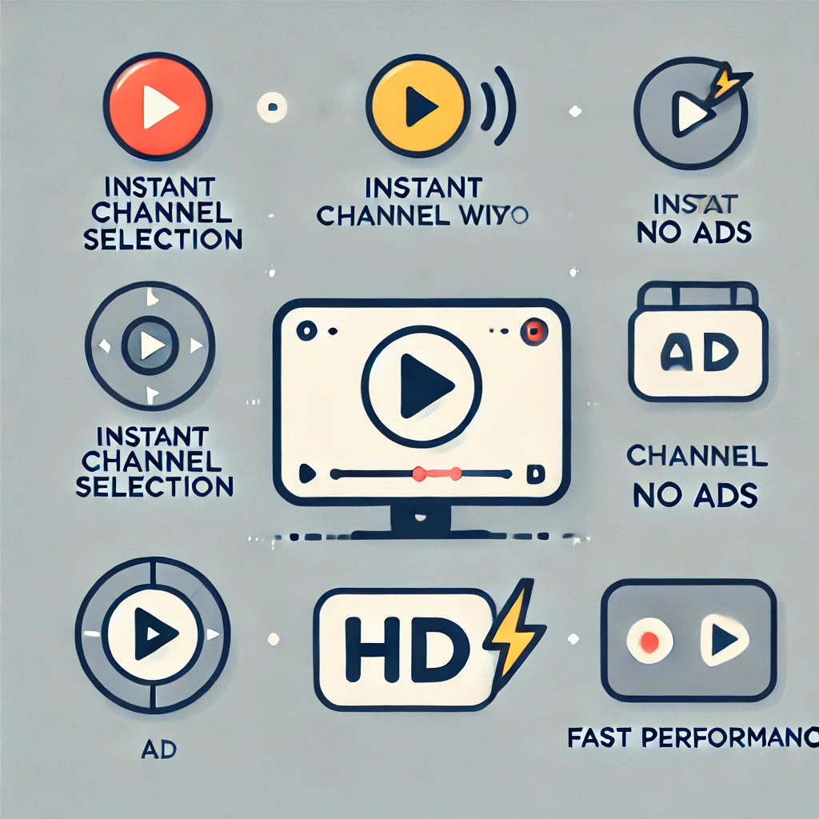
Key Features:
Instant Channel Selection 🎯
No Ads, No Distractions 🚫
High-Quality Playback 🎥
Elegant & Minimalist UI 🎨
Lightweight & Fast ⚡

Slide 23
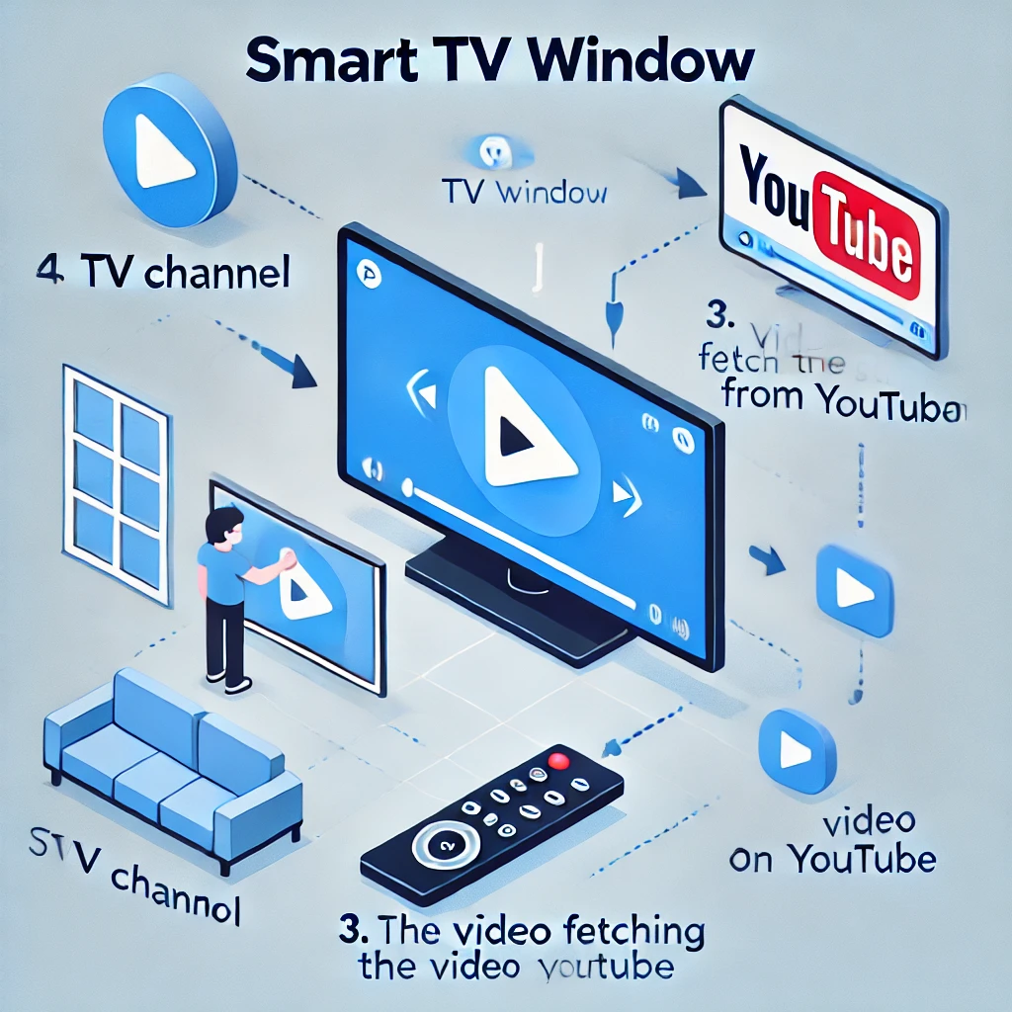
How It Works:
1️⃣ Launch the App – Smart TV Window opens in fullscreen
2️⃣ Pick a Channel – Click a button to start streaming
3️⃣ Enjoy Seamless Playback – No buffering, no hassle
4️⃣ Switch or Exit Anytime – One-click control

Slide 24
The Technology Behind It
💻 Built with:
PyQt5 – Modern UI framework
VLC Media Player – High-quality video playback
yt-dlp – Extracts direct YouTube streams
🔧 Optimized for Windows & Linux

Slide 25
Infotainment System
APP
Voice command
camera feed
Control buttons
Navigation

Slide 26
Lane Detection and Camera Integration
Capture video/recorded
camera feed/camera label
LaneDetector
check_object_position
draw_parking_guidelines
CameraThread’
setup_camera_section
frame_captured
car_position_changed

Slide 27
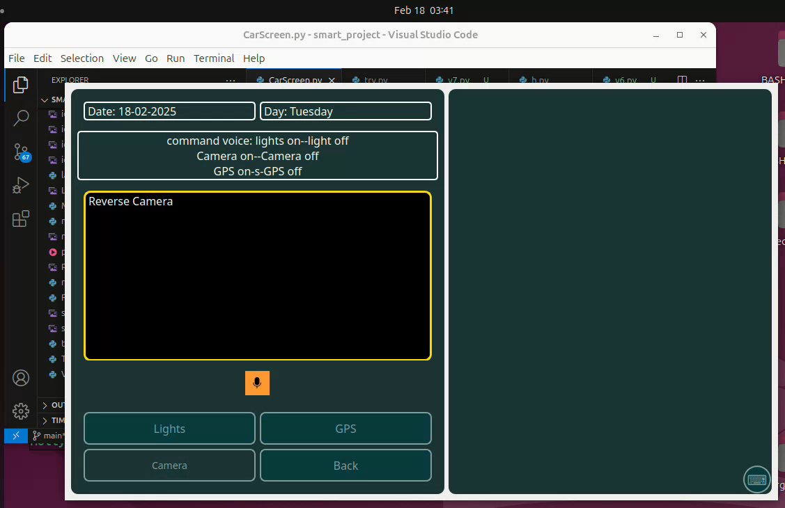
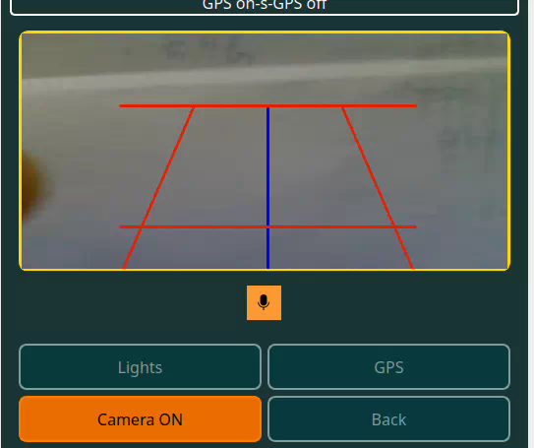
Lane Detection and Camera Integration

Slide 28
1
2
3
Voice command functionality
Voice Thread
Setup listening
handle_voice_command
To increase safety.
Listening_status
Command_detected
Control button pressed

Slide 29
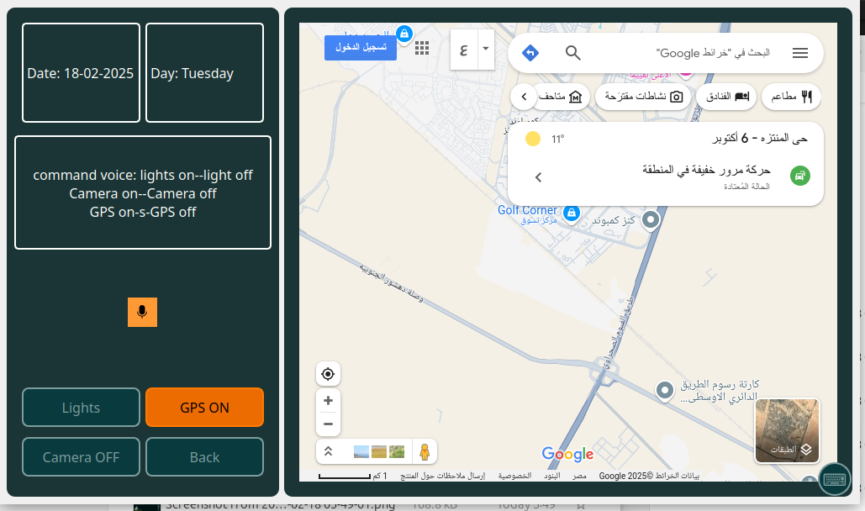
1
2
3
Simple Navigation
Voice Thread
Setup map layout
Toggle GPS
Control button pressed

Slide 30
Using Plymouth
/usr/share/plymouth/themes/
sudo plymouth-set-default-theme Ours
sudo update-initramfs -u
Logo on BOOTING

Slide 31

Conclusion
04
The art of work

Slide 32
Conclusion and Future Work
Handle CV Model
Accurate detection for car
Integrate ADAS features
H.W & S.W
Integrate Bluetooth
Add Function On-Keyboard
Lightweight model

Slide 33

Live Demo

Slide 34
Thanks!
Do you have any questions?

